Slide 1
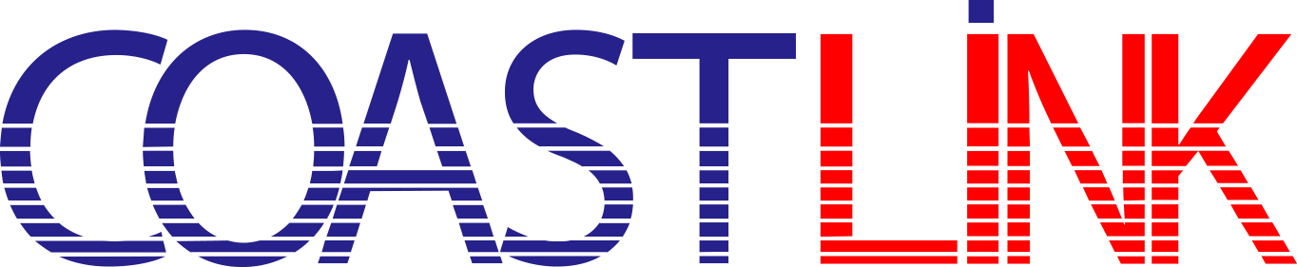
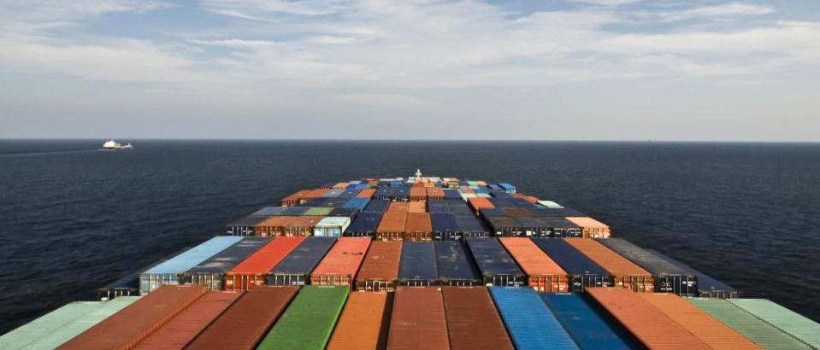
We ship
We care
Country leading group-age logistics service

Slide 2

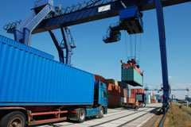
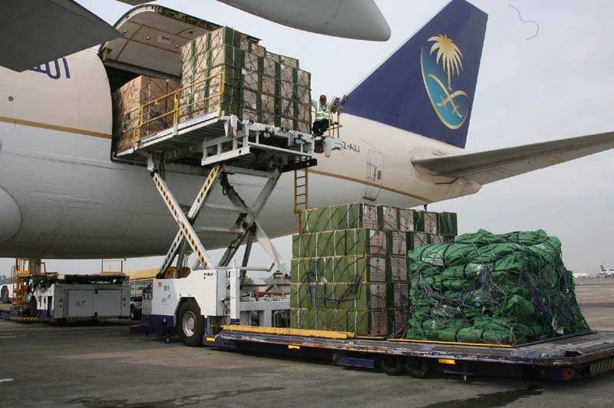

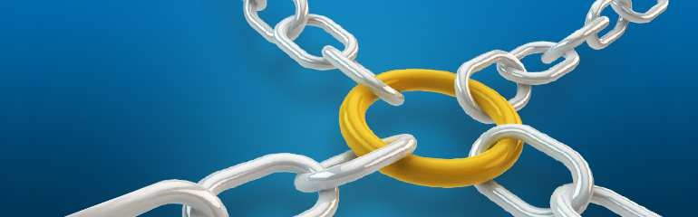
about us
1
Whatever your needs, CoastLink Logistics Ltd., will tailor a solution for your business with the worldwide network, CSTL enables door-to-door movement, visibility and control of all international ocean freight. With our dedicated freight team, you can be assured that your needs in both quality and coverage are served.
CSTL will identify your optimal logistics solution in terms of best time-to- cost variation. Based on the specific requirements, CSTL can consolidate your LCL (Less than Container Load) shipments or arrange for your FCL (Full Container Load) needs. Our long term relationships with carriers, allows us to offer you delivery flexibility and a competitive price.
CSTL is not only a leading Freight forwarder but we have our own NVOCC (Non Vessel Operating Common Carrier) can act as your virtual carrier for both LCL and FCL. As a carrier we are able to issue our own Bills of Lading giving us opportunity to control in the cost and move of your cargo. we are able to provide visibility and transparency of your shipments, giving you peace of mind that your shipments are in safe hands.
CSTL’s tracking & tracing system provides full transparency along the entire supply chain. Our Information Management Systems provide complete visibility and can easily take care of updating your in-house IT systems for all of your shipment details. With our online systems, we are able to offer faster document processing whilst increasing shipment visibility during transit.
CSTL using the latest freight forwarding shipping tools, which you can rely on to manage your shipments’ specific needs. Our personal commitment to deliver proactive worldwide solutions is the foundation on which CSTL is built upon.

Slide 3


services
2
Sea freight
Worldwide shipping
Door to Door Service
Consolidations and Full Container Loads
Flexi Tank
Air freight
Domestic and International Air Freight
Door to Door Service
Export Warehousing & Packing
Import Traffic
International Door to Door Service
IGM Submission
Inland Transportation
Warehousing
Cargo Insurance
Cargo Insurance Specialist
Full Liability Coverage
Door-to-Door Insurance
Local responsive representation
Customs broker
ACE Filing, ISF Compliance
FDA, USDA Processing
C-TPAT Certified
Continuous Bonds
Automation
Track and Trace Shipments
Electronic Data Interchange
Customized Reports
Custom Application Development

Slide 4



LESS THAN CONTAINER LOAD (LCL)
LCL
service
3
At CoastLink Logistics Ltd., we recognize the importance of LCL which is why we invest heavily into the systems development. Our annual LCL volumes are over 15,000 cbms.
We offer a comprehensive global network for both traditional LCL as well as LCL/FCL or ‘Buyers consolidations’ from both single and multiple countries.
CoastLink Logistics Ltd., in house systems control cargo flow, shipment information, speed, accuracy and cost efficiency giving you assurance that we are managing your full requirements.
Our first priority is to serve all major markets with direct consolidations through our strong network of National Gateways. Multinational Gateways act as backup for direct consolidations by running in-house feeder systems in most major markets.
CoastLink Logistics Ltd., itself country leading NVOCC who never allow to use Co-loading out with third party NVOCCs to avoid loose control with the shipment and keep in right track the goods until reach and deliver the goods to consignee’s or their nominated customs brokers hand.
By working with reputable carriers more than decades, we offer a fast, cost efficient and reliable LCL service, which aims to build on your company’s competitiveness.
we are able to provide visibility and transparency of your shipments, giving you peace of mind that your shipments are in safe hands.
Country leading group-age Logistics

Slide 5

FULL CONTAINER LOAD (FCL)
FCL
service
4
As one of the country leading forwarder service provider, for FCL, our specialized and dedicated team negotiates with all major carriers to ensure quality, space allotment and optimal pricing.
Through our web enabled IT solutions, we are able to provide visibility and transparency of your shipments, giving you relax enough that your shipments are in safe hands.
To make sure the best possible procurement with the carriers, our team of specialist negotiators will leverage CSTL volume potential to secure you the most competitive freight rates. Our skill negotiations through our Carrier Procurement Program ensures that your shipping costs are lowest which can ensure you are not charging by excessive ocean freight costs or insufficient contracts.

Slide 6
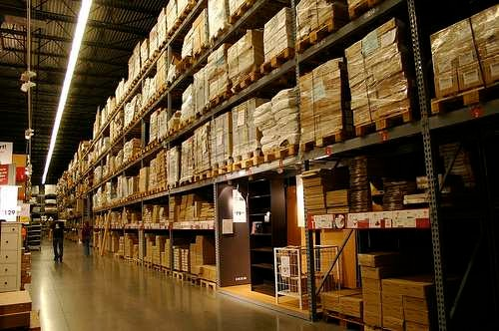
Air Freight Worldwide
Air
Freight
5
If your international freight needs to be there NOW, then you need an air freight service. With the capacity and flexibility to get it there NOW, our global network and extensive international agency will tailor a solution to get your product where it needs to be, right when you need it there. Whether it’s an urgent last minute order, a small shipment of samples or pallet loads, air freight is the fastest way to get your product to any location worldwide.
Air freight solutions can be flexible for one-off movements or regular air cargo movements. We offer services:
Day definite
Air console
Door to Door
Airport to Airport
Door to Airport
Airport to Door
Air Freight Tracking
We understand air freight is a premium international freight service and will likely be time-critical. So it’s important to you to know where your product is and when it will be delivered. With WPL’s online track and trace, you’ll see where your air freight shipment is at all times giving you and your customer full visibility, and enabling you to plan your work load

Slide 7
Customs Brokerage Service
Brokerag
6
Whether your goods need to clear customs or move in bond, CSTL's team of customs clearance and brokerage professionals can prepare and submit your Customs entry or declaration quickly and accurately, ensuring full compliance with all local regulations. Our electronic filing solutions provide efficiency and consistency, moving your freight on to destination. Anywhere, any time, on time.
Export compliance / Export clearances
Export restrictions and regulations can change rapidly in the global marketplace. CSTL's team of Export professionals monitor these changes closely, and ensure that your export shipments are in full compliance with any necessary commodity license controls, security filings, and restricted party screening requirements.
Import compliance
Import Compliance is more important than ever before. CSTL's team of Import professionals are trained to identify regulations from all government agencies, ministries or bureaus that may apply to the commodity you are importing. We can assist you in obtaining any necessary permits certificates or licenses to keep your freight moving forward.
Post-entry
Sometimes, changes to your Customs entry or declaration are required after the clearance process. CSTL's team of Post Entry specialists can assist you with the preparation and submission of any necessary post entry corrections to ensure accuracy and compliance.
Duty drawback / Reclaim
A large percentage of eligible duty drawback and duty reclamation claims are never filed. CSTL's team of Duty Drawback Professionals can help you determine if your goods qualify for a duty refund program, and assist you with the recovery of these funds.
Free Trade Agreement qualification
Your products may be eligible for preferred treatment under one of the many Free Trade Agreements currently in place around the globe. To maximize your duty savings, CSTL's team of Trade Professionals can help your organization review the applicable Rules of Origin, determine if your products qualify for benefits, and ensure that you are in full compliance with the Free Trade Agreement requirements.

Slide 8
Add value to your supply chain and simplify your day
Inland
Transport
7
CSTL’s Domestic arm is a licensed truck broker with our own contract. Our Domestic Transportation staff will act as a liaison between customers and inland transportation companies. CSTL will arrange central procurement of truck contracts and handle Inland Transportation for CSTL offices & global partners, as well as outside freight forwarder & NVOCC customers.
Through our value added services, we strive to optimize all your transportation costs.
Offering:
An extensive network of national, regional and local transport providers, including over 10 asset based motor carriers to reduce cost and increase service controls
Constant monitoring and quality assurance time-saving and cost
efficient single point of contact Variety of LTL, FTL and specialty equipment types timely pick-up and delivery, spot Rate options for larger shipments.
In addition to our Domestic offerings, as a licensed neutral NVOCC and Airfreight Wholesale provider, we consider ourselves a one stop shop for logistics needs. To learn more about CSTL international Air and Ocean products visit www.coastlinkbd.com.

Slide 9
Sea – Air
Sea – Air
8
CoastLink Ltd., offering Sea-Air concept, this can save your time, 35-60% faster than sea freight and 30-50% cheaper than air freight.
This service is available from Bangladesh to Europe, America and Latin America. We ship freight to our Dubai (United Arab Emirates), Colombo (Sri Lanka) terminals and fly it to its final destination.
Sea-Air cargo is the last to be loaded and the first to be unloaded, reducing transshipment times and risk.
CSTL offering the best elements of both air and ocean freight, CSTL offers multiple weekly vessel departures from Chittagong to connect schedule of m/vessel based on pre booked onward flight from trans- shipment ports to meet customers desired delivery date.
The best way we can say…
100% CSTL product with neutrality guaranteed
Freight collect accepted
Door deliveries and DDP service
Metropolitan city airport arrivals reducing post-carriage costs and T/T from seaport to final destination

Slide 10
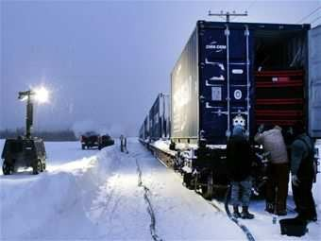
FLEXI TANK
www.coastlinkbd.com

Slide 11
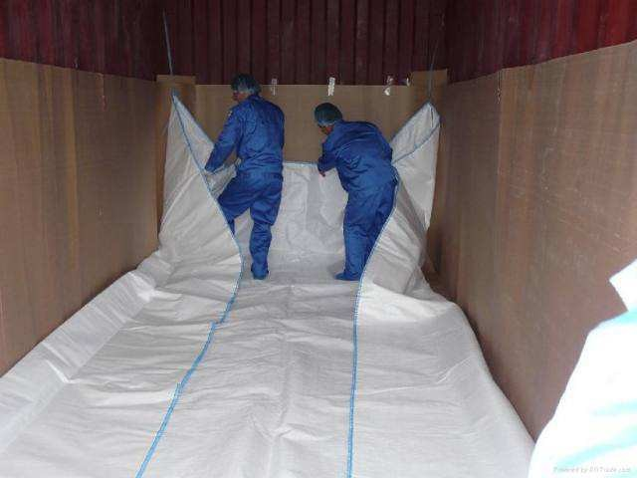
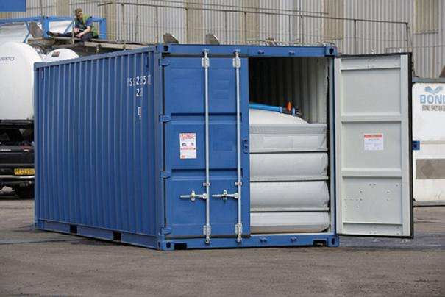
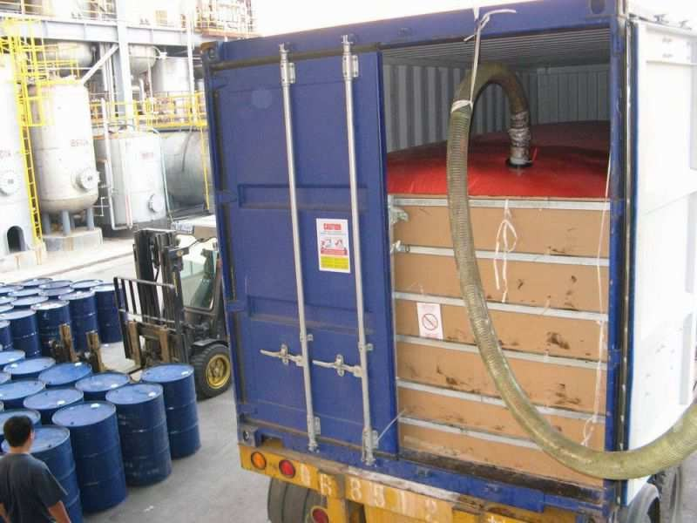
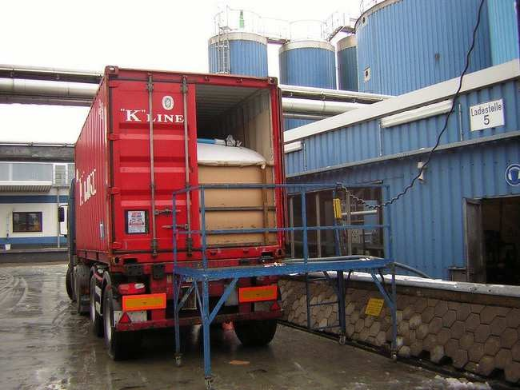
A FLEXITANK is special equipment for transportation bulk non-hazardous cargoes, using the standard 20-foot sea container.
A FLEXITANK is a special, soft and tight tank with volume from 14 up to 24 thousand liters. FLEXITANK is produced from polyethylene material.
How does a Flexitank Work?
A FLEXITANK is Installed in a Normal 20-foot container the process of which takes just 20 Minutes or so ! After the Fitting is done, the Flexitank Container is Ready to load your Cargo of Non Hazardous Liquid. The Installation of our FLEXITANK can be done at Our WPL Flexi Depot or at your premises or any other Place of Loading. All you have to do after the process of Installation is to hook up your Connecting Device to the FLEXITANK. By using a Pump, the Loading can commence immediately. Loading of a Flexitank take approximate 30-40 minutes depending on type of a cargo and the capacity of the Pump ! After loading is completed, the Container, along with the Flexitank and your valued Cargo is delivered to the Carriers Stack for onward movement to ANY Destination or from ANY point of Origin in the world . The Flexitank Container can be transported by Road, Rail or Sea just as a Normal Shipping Container would. Either your Buyer / Agent can perform the Discharge or we can provide Destination and Origin Services through our Worldwide Network Partners. It is a simple procedure and we are able to provide an Operations Manual with Instruction to you for easy handling. After the Unloading by a Pump is finished, the used Flexitank can be disposed !
What is a Flexitank fit to carry?
A FLEXITANK can carry almost ANY type of NON Hazardous Liquids for both, Industrial and Food applications. Here are some major Items that are suitable for Flexitank Movements :
Edible Oils and Fatty Liquids (in both Liquid and semi Solid Form), Juices, Concentrates, Syrups, Water, Wine, Malt Food Additives, Pharmaceuticals , Animal Extract Oils, Sorbitrate, Lubricants, Technical Additives, Synthetic Pitches, Cleaning Liquids, Emulsions, Glycerin, Paints , Inks, Fertilizers, Latex, Transformer Oils.
For Semi Solid Liquid material that have properties to get Thick during storage due to Low Temperatures, we provide special Heating Pads to cover the Flexitank in order to maintain a Free Flow state during Loading and Discharging Operations. This Heating Pad is installed together with the Flexitank by using Steam or Hot Water that allows an Increase in Temperature.

Slide 12
Advantage Flexitank:
FLEXITANK is an ideal and economical alternative to Standard means of Transportation as in Tank Containers, Railways Tank Wagons, Road Tankers, Drums and other usual methods of Shipping Non Hazardous Liquids..................
You will significantly reduce expenses for transportation. In comparison with tank-container you will pay just for one way freight of the 20-foot container. There is no need to return container and pay for leg. It is one way transportation system with no hidden costs.
You can use FLEXITANK as a packaging material for your Liquid Cargoes instead of using Drums thereby saving a massive 30-40% over packaging Costs.
You can save up to 90 % of time for loading and unloading of the cargo via Flexi tanks as against other Methods.
There is NO need to clean a FLEXITANK after transportation as it is disposable. For every loading, a New Flexitank is provided so there is No Chance of Contamination or extra expenses. You can Reduce Losses of cargo material by using Flexi tanks.
There is no wastage and as a comparison the residue left in a Flexitank is 0.1% as compared with the 1% of Cargo Loss when using Drums in fact even more when using Road Tankers.
You will increase volume of a cargo for transportation. In comparison with the standard packaging as in drums. The Volume can be increased up to 30 %.
There is NO possibility of Pilferage from Flexitank as this is a Seal Unit with no chance for removal of Liquids en route the cargo in Flex tanks is delivered Door to Door without Intermediate Overloads or diversions
Flexitank Guarantees:
FLEXITANKS are used all over the World since years on end. Their design features are suitable for Liquid Transportation after stringent manufacturing Controls imposed by International Competent Authorities and Organizations. The Flexitank Material has been bettered and improved upon with superior raw material that are known to be robust in nature. Stricter quality controls are applied during the manufacturing process of a FLEXITANK. Each FLEXITANK has its own unique identification number hence there is an Individual Monitoring of the usage for the entire Supply Chain. These conditions enable the Manufacturer to be liable and responsible for any incident as a result of a default of any manufacturing defect. There is a world class Insurance coverage in case of a Leak or a cargo Loss due to any shortfall from the Manufacturers side.

